Slide 1

WEEK 07 · CYBERSECURITY INTERNSHIP
Web Application VAPT
A full Burp Suite engagement against DVWA
Vulnerability Assessment and Penetration Testing engagement run end-to-end through Burp Suite, with a written report at the end.
DG Interns Hub — Cybersecurity Track
OCTOBER 2025
DVWA LAB ONLY · OWASP WSTG V4.2 · BURP SUITE COMMUNITY EDITION

Slide 2
02 · THE ENGAGEMENT
Engagement scope
Week 7 deliverable was a full VAPT engagement against DVWA. Coming from active bug bounty work on HackerOne and Bugcrowd, the goal here was running a clean, repeatable end-to-end manual workflow and documenting it to a professional standard — not discovering new vulnerability classes.
◯
Target Application
⚒
Testing Stack
✓
Practice Targets
DVWA v1.9 — Damn Vulnerable Web App
OS: Kali Linux 2024.2
Browser: Firefox 128 + FoxyProxy 7.x
Per the Week 7 brief, authorised safe targets only:
Stack: XAMPP / Apache 2.4 + PHP 7.4 + MariaDB 10.4
DVWA · OWASP Juice Shop · TestPHP (demo.testfire.net)
Endpoint: http://localhost/dvwa
Proxy: Burp Suite CE 2024.x
Content discovery: Dirsearch 0.4.3
Security levels: low → medium → high
Engagement used DVWA. No production systems, no third-party sites, no real-world targets tested.
Default creds: admin / password (initial authenticated session)
Cross-check: Gobuster 3.6.0
Target: DVWA 1.9
Demo apps only — strictly lab scope
Maintained by the OWASP community
All traffic stayed on 127.0.0.1
Week 7 VAPT · DG Interns Hub
02 / 10

Slide 3
03 · TASK 22 · SETUP & INTERCEPTION
Burp Suite setup & interception chain
Five sub-tasks from the Week 7 brief — install, configure, intercept, trust, capture. Each completed during the engagement to wire the chain: browser → proxy → app and back.
01
✓
02
✓
03
✓
04
✓
05
✓
↓
⚙
◌
⛨
✓
Install Burp Suite CE
Configure Browser Proxy
Intercept HTTP/HTTPS
Install Burp CA Certificate
Capture Login Request
Burp Suite Community Edition installed on Kali Linux 2024.2 from portswigger.net. Default options. Proxy, Target, Repeater, Intruder, Decoder tabs loaded.
Every request and response between browser and DVWA captured in Burp Proxy > Intercept. Inspected, modified, or forwarded on demand.
DVWA login POST at /dvwa/login.php captured in cleartext body — username + password visible. Session cookie returned on forward. Setup chain confirmed.
Firefox routed at 127.0.0.1:8080 via FoxyProxy toggle. HTTP and HTTPS traffic paused inside Burp until forwarded, modified, or dropped.
PortSwigger CA cert imported into Firefox Authorities via http://burp/cert. Green padlocks on HTTPS, full request/response decryption enabled.
→
→
→
→
COMPLETED
COMPLETED
COMPLETED
COMPLETED
COMPLETED
Week 7 VAPT · DG Interns Hub
03 / 10

Slide 4
04 · TASK 24 · VULNERABILITY TESTING — SQL INJECTION
When input becomes query
An unfiltered login field lets the whole authentication check be bypassed, then the rest of the database read at will.
CAPTURED REQUEST
Authentication Bypass
CRITICAL SEVERITY
The user input is concatenated directly into the SQL auth query. The payload closes the string and comments out the password check, or forces a tautology that always returns true. Login is granted without valid credentials.
Real-World Impact
INJECTED PAYLOAD — SENT TO REPEATER
Full authentication bypass on any login form with the same flaw
UNION SELECT attacks extract the entire users table — credentials, PII, sessions
Pivot to other databases on the same MariaDB instance
Remediation
STEPS TO REPRODUCE
1. Set DVWA security to low. 2. Submit login form — Burp intercepts the POST. 3. Send to Repeater (Ctrl+R). 4. Replace username value with payload. 5. Send — response 302 redirect, Set-Cookie = authenticated session.
Parameterized queries / prepared statements — never string-concat SQL
Input validation allow-lists on username field
Least-privilege DB user — app account cannot read other schemas
Week 7 VAPT · DG Interns Hub
04 / 10

Slide 5
05 · TASK 24 · VULNERABILITY TESTING — XSS
Same bug, two flavors
Unvalidated input that lands in the response body — either as a one-shot reflection, or persisted in the database and fired on every page load.
HIGH SEVERITY
REFLECTED
HIGH SEVERITY
STORED
⚡
Reflected XSS
▦
Stored XSS
Payload travels in the URL / query string, gets reflected into the response HTML without encoding, fires in the victim browser on visit.
Payload submitted through the guestbook comment field is persisted into MariaDB. Every visitor who loads the page executes the script in their own session.
STEPS
— submit form → intercept in Burp → send to Repeater → confirm <script> tag in response HTML
Cookie theft, session hijack, credential phishing via DOM redirects.
— submit guestbook form → intercept in Burp → send to Repeater → reload page → confirm payload executes
STEPS
Persistent, wider reach — wormable in admin panels.
⛨
Remediation —
Context-aware output encoding (HTML, JS, URL, attribute contexts each have different escape rules), Content-Security-Policy headers with no unsafe-inline, input sanitization libraries as defense-in-depth.
Week 7 VAPT · DG Interns Hub
05 / 10

Slide 6
06 · TASK 24 + 25 · ADDITIONAL FINDINGS
Three more findings + directory discovery
Tasks 24 and 25 wrapped into one view — three more vulnerability classes from the OWASP Top 10, plus the directory and endpoint discovery run against the application root.
TASK 24
HIGH
TASK 24
HIGH
◯
Weak Credentials
→
Insecure Direct Object Reference
Default DVWA creds admin / password accepted. No account lockout. No MFA. Brute-forcing was effectively free.
Changing ?id=1 to ?id=2 in the user profile URL returns another user's data — no re-auth, no server-side authorization check.
REMEDIATION
REMEDIATION
Strong password policy. Account lockout after N failed attempts. MFA on admin accounts. Rate-limit login endpoint.
Server-side authz check per request. Indirect object references (session → object). Replace sequential IDs with UUIDs. Default-deny access control.
TASK 24
MEDIUM
TASK 25
MEDIUM
↻
CSRF + Brute Force (Intruder)
✦
Directory & Endpoint Discovery
No CSRF token on state-changing endpoints. Burp Intruder ran a wordlist against the password field — admin creds recovered in seconds.
Dirsearch + Gobuster ran common-path wordlists against the application root. Hidden endpoints discovered — including /admin, /login, /api/, and backup files.
REMEDIATION
REMEDIATION
Anti-CSRF tokens validated server-side. SameSite=Strict cookies. Rate-limit + CAPTCHA on login. Long random session IDs.
Restrict /admin by IP whitelist. Remove backup files (.bak, .old) from web root. Disable directory listings. Enforce 404 on unknown paths.
Week 7 VAPT · DG Interns Hub
06 / 10

Slide 7
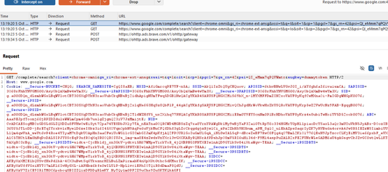
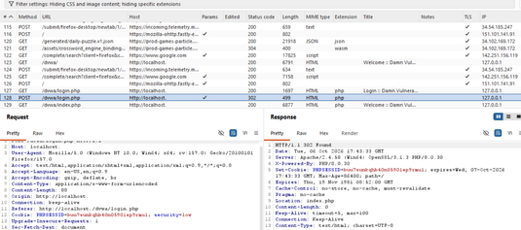
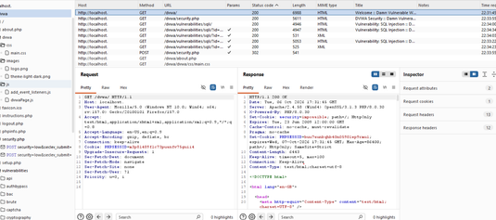
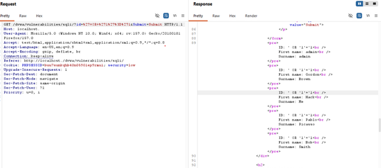
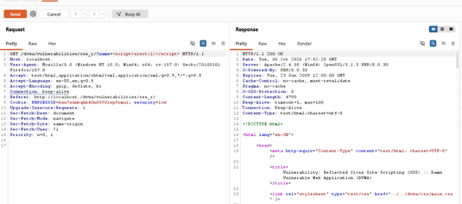
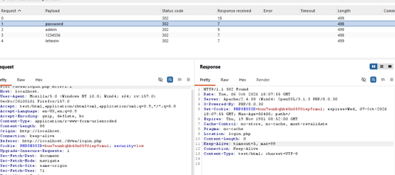
07 · TASK 26 · VISUAL PROOF
Evidence captured from the live engagement
Six screenshots pulled directly from the Burp Suite session against DVWA — covering the three required Burp tools: Proxy (intercept + login captured + site map), Repeater (SQLi bypass + reflected XSS payload), and Intruder (brute force results).
01
Burp Intercept Enabled
02
DVWA Login Captured
03
DVWA Target Site Map
PROXY
PROXY
TARGET TAB
04
SQL Injection Bypass — users dumped
05
Reflected XSS Payload in Burp
06
Brute Force Results
REPEATER
REPEATER
INTRUDER
Week 7 VAPT · DG Interns Hub
07 / 10

Slide 8
08 · TASK 26 · RISK MATRIX
Findings at a glance
Six vulnerability classes tested, all confirmed exploitable on DVWA — overall risk rating HIGH.
CRITICAL
SQL Injection — Authentication Bypass · TASK 24
6 / 6
HIGH
Stored XSS · TASK 24
Reflected XSS · TASK 24
Auth Bypass — Weak Creds · TASK 24
vulnerability classes confirmed exploitable
IDOR · TASK 24
OVERALL RISK RATING
HIGH
MEDIUM
CSRF + Brute Force · TASK 24
Directory & Endpoint Discovery · TASK 25
These are DVWA's intentional flaws — but unsanitized SQL, unencoded output, predictable session handling, missing CSRF tokens, and exposed admin endpoints still ship in production web apps today.
Internal IP Disclosure · TASK 22
LOW
Missing Security Headers · TASK 25
Server Version Disclosure · TASK 22
Week 7 VAPT · DG Interns Hub
08 / 10

Slide 9
09 · TASK 26 · REMEDIATION + REPORT STRUCTURE
Code-level fixes + report structure
The written VAPT report covers each finding across all six required fields — Name, Description, Steps to Reproduce, Proof, Impact, Remediation. Code-level fixes below would close each class at the source.
✦
Code-level fixes
▤
Report structure per finding
1 Parameterized queries + ORM-safe defaults — kill SQLi at the source.
2 Context-aware output encoding for every XSS surface (HTML, JS, URL, attribute).
3 Server-side authorization check per request — close IDOR at the gate.
4 Anti-CSRF tokens + SameSite=Strict cookies on state-changing endpoints.
5 Rate-limit + account lockout + MFA on login — brute force stops being free.
6 Restrict /admin by IP whitelist. Remove backup files from web root. Hide server/framework versions.
Each of the 3+ working vulnerabilities documented in the written report follows the same six-field structure required by Task 26:
⌧
Vulnerability Name
✦
Description
▤
Steps to Reproduce
◉
Proof (Burp screenshot)
⚠
Impact
⚒
Remediation
3 vulnerabilities documented in the 26-page written report.
✓
Manual testing through Burp Repeater finds the bugs scanners miss. A clean workflow and a written report are what make a VAPT engagement useful to a dev team.
Week 7 VAPT · DG Interns Hub
09 / 10

Slide 10
WEEK 07 · ENGAGEMENT CLOSED
Engagement closed.
DVWA tested end-to-end through Burp Suite — six vulnerability classes confirmed, risk matrix produced, written report delivered.
◆
Engagement takeaway
Manual testing through Burp Repeater finds the bugs scanners miss. A clean, repeatable workflow and a written report are what make a VAPT engagement useful to a development team — that is what Week 7 was about.
DVWA LAB ONLY · NO PRODUCTION SYSTEMS TESTED · OWASP WSTG V4.2

